Slide 1
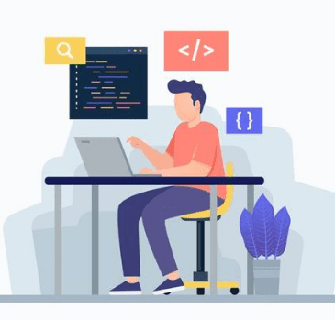
CS 703 Applied Data Science Project Weekly Status Report
Professor Nicholas Nardi
Spring 2026

Slide 2
Predictive Pricing Analysis for The USA Housing Market Status Report Week Ending May 9, 2026 Submitted by Gordon Oboh May 10, 2026

Slide 3
Agenda…
Status Overview…
Items Completed in Current Week…
Items In Progress…
Items To Be Started…
Samples of Items Completed This Week…
Issues, Risks, Concerns…
Next Steps…
Personal Reflection…

Slide 4
Status Overview…
Project Status is Yellow
Phase 1: Project Proposals — business problem identified and documented
Original Start: May 4, 2026 | Revised Start: N/A | Actual Start: May 4, 2026
Original End: May 9, 2026 | Revised End: N/A | Actual End: May 9, 2026
1.0 Business Understanding — in progress; dataset not yet confirmed
Original Start: May 4, 2026 | Revised Start: N/A | Actual Start: May 4, 2026
Original End: May 9, 2026 | Revised End: N/A | Actual End: N/A
Still searching for a suitable dataset; data availability is currently uncertain
No other major issues

Slide 5
Items Completed in Current Week…
Phase 1: Project Proposals Document
Task is GREEN — 100% complete
Original Start: May 4, 2026 | Revised Start: N/A | Actual Start: May 4, 2026
Original End: May 9, 2026 | Revised End: N/A | Actual End: May 9, 2026
Identified and documented two project ideas; primary focus confirmed as housing amenity impact on U.S. rental pricing.

Slide 6
Items In Progress…
1.0 Business Understanding
Task is Yellow — 75% complete
Original Start: May 4, 2026 | Revised Start: N/A | Actual Start: May 4, 2026
Original End: May 9, 2026 | Revised End: N/A | Actual End: N/A
Business problem and scope defined; still searching for a suitable dataset
Anticipate completing 1.0 Business Understanding once data source is confirmed

Slide 7
Items to Be Started…
1.1 Determine Business Objectives (subsection of current 1.0)
Original Start: May 10, 2026 | Revised Start: N/A | Actual Start: N/A
Original End: May 11, 2026 | Revised End: N/A | Actual End: N/A
1.2 Assess Situation
Original Start: May 11, 2026 | Revised Start: N/A | Actual Start: N/A
Original End: May 12, 2026 | Revised End: N/A | Actual End: N/A
2.0 Data Understanding (next CRISP-DM phase)
Original Start: May 13, 2026 | Revised Start: N/A | Actual Start: N/A
Original End: May 24, 2026 | Revised End: N/A | Actual End: N/A

Slide 8
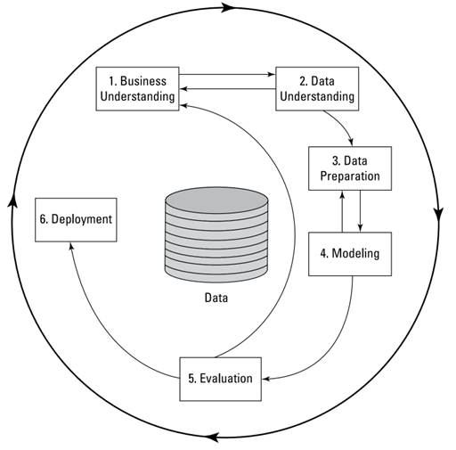
Sample of Items Completed This Week…
CRISP-DM Methodology — Project Framework
The diagram below shows the CRISP-DM process model guiding this project. Phase 1 (Business Understanding) is the current active phase.

Slide 9
Project Issues, Risks, Concerns…
Issues
None at this time
Risks
Dataset availability: a suitable rental listing dataset may not be publicly accessible; evaluating Kaggle and other public repositories
Concerns
None at this time

Slide 10
Next Steps…
Complete 1.0 Business Understanding
Original Start: May 4, 2026 | Revised: N/A | Actual Start: May 4, 2026
Original End: May 9, 2026 | Revised: N/A | Actual End: N/A
1.1 Determine Business Objectives
Original Start: May 10, 2026 | Revised: N/A | Actual Start: N/A
Original End: May 11, 2026 | Revised: N/A | Actual End: N/A
1.2 Assess Situation
Original Start: May 11, 2026 | Revised: N/A | Actual Start: N/A
Original End: May 12, 2026 | Revised: N/A | Actual End: N/A
Begin 2.0 Data Understanding
Original Start: May 13, 2026 | Revised: N/A | Actual Start: N/A
Original End: May 24, 2026 | Revised: N/A | Actual End: N/A

Slide 11
Personal Reflection…
Week 1 has been an interesting start. Coming in, I had a general sense of what I wanted to work on, but actually having to articulate the business problem in a structured way made me realize how much thought goes into framing a data science project before any data is touched.
The biggest uncertainty right now is the data. I know what I want to analyze, but finding the right dataset is proving to be the first real challenge. I am feeling cautiously optimistic, but I want to make sure the data actually supports the questions I am trying to answer before committing fully to the project direction.

Slide 12
Thank You!...

Slide 13
Sample of Items Completed This Week…
test.py — Environment Validation Script
Confirms Python environment is active and dependencies are available.
Code:
print("Hello")
Full project code: Capstone_Final.ipynb (available in repository)

Slide 14
Sample of Items Completed This Week…
Model Performance Metrics — KPM/model_performance_metrics.csv
Model | MAE | MSE | RMSE | R2 | ASE | SSE | ObservedAvg
Random Forest | 62.7 | 18989.3 | 137.8 | 0.922 | 18989.3 | 1377803258.9 | 1140.94
Gradient Boosting | 150.68 | 48890.3 | 221.11 | 0.799 | 48890.3 | 3547336339.3 | 1140.94
XGBoost | 124.33 | 34454.2 | 185.62 | 0.858 | 34454.2 | 2499892791.2 | 1140.94

